Slide 1



React list and React Keys
Praveen

Slide 2
Agenda
Introduction
Define React list
Why will use react list
Example of list

Slide 3
Agenda
Introduction
Definition of keys
Why will use react keys
Example of keys in react

Slide 4
React lists
Lists are very useful when it comes to developing the UI of any website. Lists are mainly used for displaying menus in a website, for example, the navbar menu. In regular JavaScript, we can use arrays for creating lists. We can create lists in React in a similar manner as we do in regular JavaScript. We will see how to do this in detail further in this article. Let’s first see how we can traverse and update any list in regular JavaScript. We can use the map() function in JavaScript for traversing the lists.
4

Slide 5
Below JavaScript code illustrate using map() function to traverse lists:
<script type="text/javascript">
var numbers = [1,2,3,4,5];
const updatedNums = numbers.map((number)=>{
return (number + 2);
});
console.log(updatedNums);
</script>

Slide 6
The above code will log the below output to the console:
Output:
[3, 4, 5, 6, 7]
Let us now create a list of elements in React. We will render the list numbers in the above code as an unordered list element in the browser rather than simply logging in to the console. To do this, we will traverse the list using the JavaScript map() function and updates elements to be enclosed between <li> </li> elements. Finally we will wrap this new list within <ul> </ul> elements and render it to the DOM.

Slide 7
The below code illustrates this:
import React from 'react';
import ReactDOM from 'react-dom';
const numbers = [1,2,3,4,5];
const updatedNums = numbers.map((number)=>{
return <li>{number}</li>;
});
ReactDOM.render(
<ul>
{updatedNums}
</ul>,
document.getElementById('root')
);

Slide 8
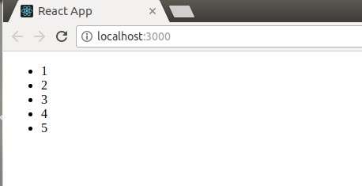
The above code will render an unordered list as shown in below output:

Slide 9
Rendering lists inside Components:
In the above code in React, we had directly rendered the list to the DOM. But usually this not a good practice to render lists in React. We already have talked about the uses of Components and had seen that everything in React is built as individual components. Consider the example of a Navigation Menu. It is obvious that in any website the items in a navigation menu are not hard coded. This item is fetched from the database and then displayed as lists in the browser. So from the component’s point of view, we can say that we will pass a list to a component using props and then use this component to render the list to the DOM. We can update the above code in which we have directly rendered the list to now a component that will accept an array as props and returns an unordered list.

Slide 10
import React from 'react';
import ReactDOM from 'react-dom';
// Component that will return an
// unordered list
function Navmenu(props)
{
const list = props.menuitems;
const updatedList = list.map((listItems)=>{
return <li>{listItems}</li>;
});
return(
<ul>{updatedList}</ul>
);
}
const menuItems = [1,2,3,4,5];
ReactDOM.render(
<Navmenu menuitems = {menuItems} />,
document.getElementById('root')
);

Slide 11
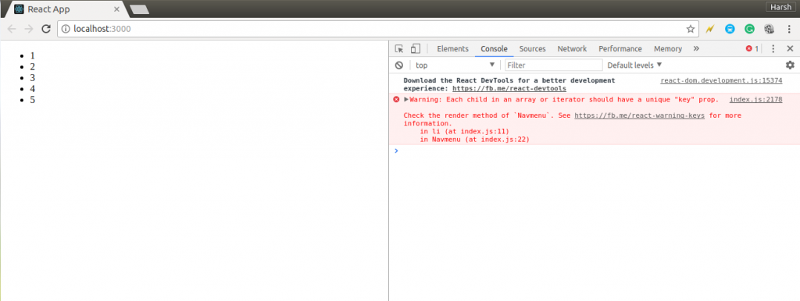
Output:

Slide 12
You can see in the above output that the unordered list is successfully rendered to the browser but a warning message is logged to the console.
Warning: Each child in an array or iterator
should have a unique "key" prop
The above warning message says that each of the list items in our unordered list should have a unique key.
A “key” is a special string attribute you need to include when creating lists of elements in React. We will discuss about keys in detail in further articles. For now, let’s just assign a string key to each of our list items in the above code.
Below is the updated code with keys:

Slide 13
import React from 'react';
import ReactDOM from 'react-dom';
// Component that will return an
// unordered list
function Navmenu(props)
{
const list = props.menuitems;
const updatedList = list.map((listItems)=>{
return(
<li key={listItems.toString()}>
{listItems}
</li>
);
});

Slide 14
return(
<ul>{updatedList}</ul>
);
}
const menuItems = [1,2,3,4,5];
ReactDOM.render(
<Navmenu menuitems = {menuItems} />,
document.getElementById('root')
);
This code will give the same output as that of the previous code but this time without any warning. Keys are used in React to identify which items in the list are changed, updated, or deleted. In other words, we can say that keys are used to give an identity to the elements in the lists.

Slide 15
why we will use list in react java script?
There are several reasons why you might use a list in a react application:
1. displaying a collection of data:
List are commonly way to display a collection of item , such as a list of products, article, other types of content.
2. Dynamic rendering :
Lists can be generated based on data from an api, a database, or other source . this allows for the list to update automatically when the data changes .

Slide 16
3. Interactivity:
Lists can be made interactive by adding event handlers to the individual items , which allows for thing like selecting an item or triggering an action, when an item is clicked.
4. Re-useability:
List can be broken down into individual components that can be reused throughout the application . this allows for a more modular and maintainable codebase.
5. Performance :
React 's virtual Dom allows for efficient updates and rendering of lists , even when the list contains a large number of items.

Slide 17
React Keys
A “key” is a special string attribute you need to include when creating lists of elements in React. Keys are used in React to identify which items in the list are changed, updated, or deleted. In other words, we can say that keys are used to give an identity to the elements in the lists. The next thing that comes to mind is that what should be good to be chosen as key for the items in lists. It is recommended to use a string as a key that uniquely identifies the items in the list. Below example shows a list with string keys:

Slide 18
const numbers = [ 1, 2, 3, 4, 5 ];
const updatedNums = numbers.map((number)=>{
return <li key={index}>{number} </li>;
});
You can also assign the array indexes as keys to the list items. The below example assigns array indexes as key to the elements.
const numbers = [ 1, 2, 3, 4, 5 ];
const updatedNums = numbers.map((number, index)=>
<li key = {index}>
{number}
</li>
);

Slide 19
Assigning indexes as keys are highly discouraged because if the elements of the arrays get reordered in the future then it will get confusing for the developer as the keys for the elements will also change.
Using Keys with Components
Consider a situation where you have created a separate component for list items and you are extracting list items from that component. In that case, you will have to assign keys to the component you are returning from the iterator and not to the list items. That is you should assign keys to <Component /> and not to <li> A good practice to avoid mistakes is to keep in mind that anything you are returning from inside of the map() function is needed to be assigned key.

Slide 20
Below code shows incorrect usage of keys:
import React from 'react';
import ReactDOM from 'react-dom';
// Component to be extracted
function MenuItems(props)
{
const item = props.item;
return(
<li key = {item.toString()}>
{item}
</li>
);
}

Slide 21
// Component that will return an
// unordered list
function Navmenu(props)
{
const list = props.menuitems;
const updatedList = list.map((listItems)=>{
return (
<MenuItems item = { listItems } />
);
});
return(
<ul>{updatedList}</ul>);
}
const menuItems = [1, 2, 3, 4, 5];
ReactDOM.render(
<Navmenu menuitems = {
menuItems} />,
document.getElementById('root')
);

Slide 22
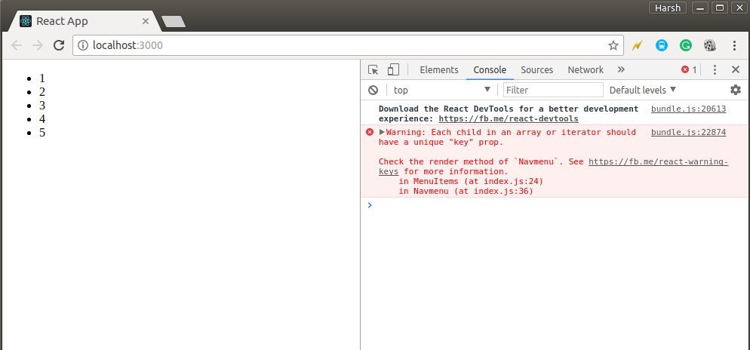
OutPut:

Slide 23
You can see in the above output that the list is rendered successfully but a warning is thrown to the console that the elements inside the iterator are not assigned keys. This is because we had not assigned key to the elements we are returning to the map() iterator.
Below example shows correct usage of keys:
import React from "react";
import ReactDOM from "react-dom";
// Component to be extracted
function MenuItems(props) {
const item = props.item;
return <li>{item}</li>;
}
// Component that will return an
// unordered list
function Navmenu(props) {
const list = props.menuitems;
const updatedList = list.map((listItems) => {
return <MenuItems key={listItems.toString()} item={listItems} />;
});

Slide 24
return <ul>{updatedList}</ul>;
}
const menuItems = [1, 2, 3, 4, 5];
ReactDOM.render(
<Navmenu menuitems={menuItems} />,
document.getElementById("root")
);
The above code will run successfully without any warning message.
Uniqueness of Keys
We have told many times while discussing about keys that keys assigned to the array elements must be unique. By this, we did not mean that the keys should be globally unique. All the elements in a particular array should have unique keys. That is, two different arrays can have the same set of keys.
In the below code we have created two different arrays menuItems1 and menuItems2. You can see in the below code that the keys for the first 5 items for both arrays are the same still the code runs successfully without any warning.

Slide 25
import React from "react";
import ReactDOM from "react-dom";
// Component to be extracted
function MenuItems(props) {
const item = props.item;
return <li>{item}</li>;
}
// Component that will return an
// unordered list
function Navmenu(props) {
const list = props.menuitems;
const updatedList = list.map((listItems) => {
return <MenuItems key={listItems.toString()} item={listItems} />;
});

Slide 26
return <ul>{updatedList}</ul>;
}
const menuItems1 = [1, 2, 3, 4, 5];
const menuItems2 = [1, 2, 3, 4, 5, 6];
ReactDOM.render(
<div>
<Navmenu menuitems={menuItems1} />
<Navmenu menuitems={menuItems2} />
</div>,
document.getElementById("root")
);

Slide 27
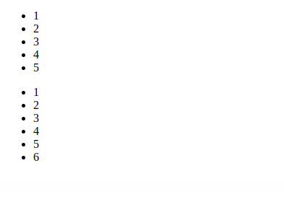
output:
Note: Keys are not the same as props, only the method of assigning “key” to a component is the same as that of props. Keys are internal to React and can not be accessed from inside of the component like props. Therefore, we can use the same value we have assigned to the Key for any other prop we are passing to the Component.

Slide 28
Why we will use keys in react JS:
There are several reason using keys in react they are:
1.Performance :
When react renders a list if elements it uses the key to keep track of each elements. If an elements changes , react assumes that the element has been removed and re-created ,and will update the component accordingly if the key stays the same , react knowns that the element is still the same and wont update it. This allow react to optimize updates and minimizes the amount of work that needs to be done.
2. Identity :keys help react to identity which items in a list are the same and which are different this is especially important when items are added to the list .By providing a unique key for each item are the same and which are different , so that it can update the Dom accessibility

Slide 29
3.Accessbility :
Using keys can also help with accessibility. As it makes it easy for users to identify elements within a list .
4.Debugging:
Keys can also make it easier to debug your application, as it can help your identify which elements
Were updated and which were not.
Key should be unique among siblings and constant also , its recommended to use a unique identifier from your data as the key if not ,use index as a key but it should be used only when data is static and you don’t have any unique identifier.

Slide 30




Thank you

